Slide 1

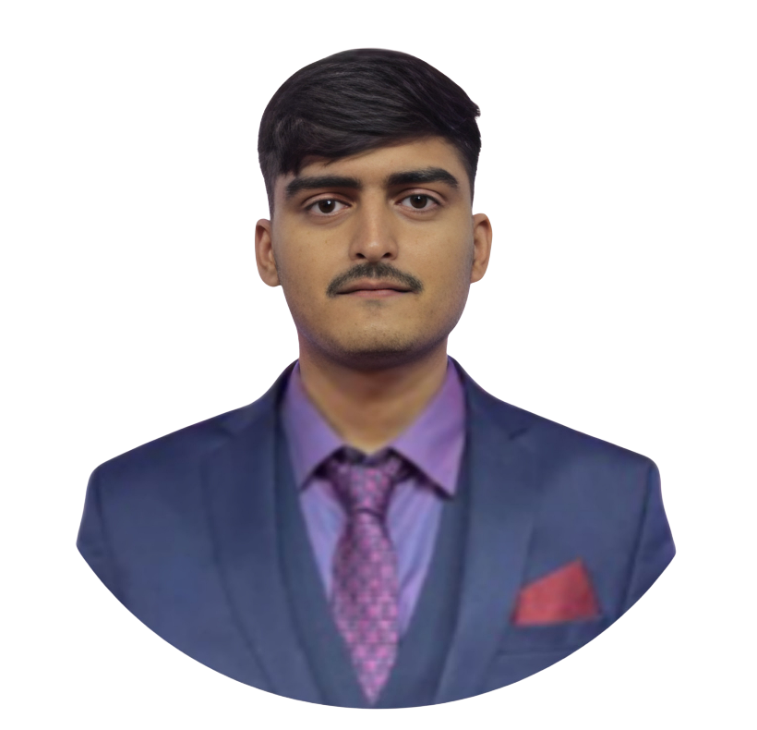
Pratik Kumar Singh
I am an
Infosys Springboard
‘InventoryManagement for a Business’ Project Intern

